Slide 1
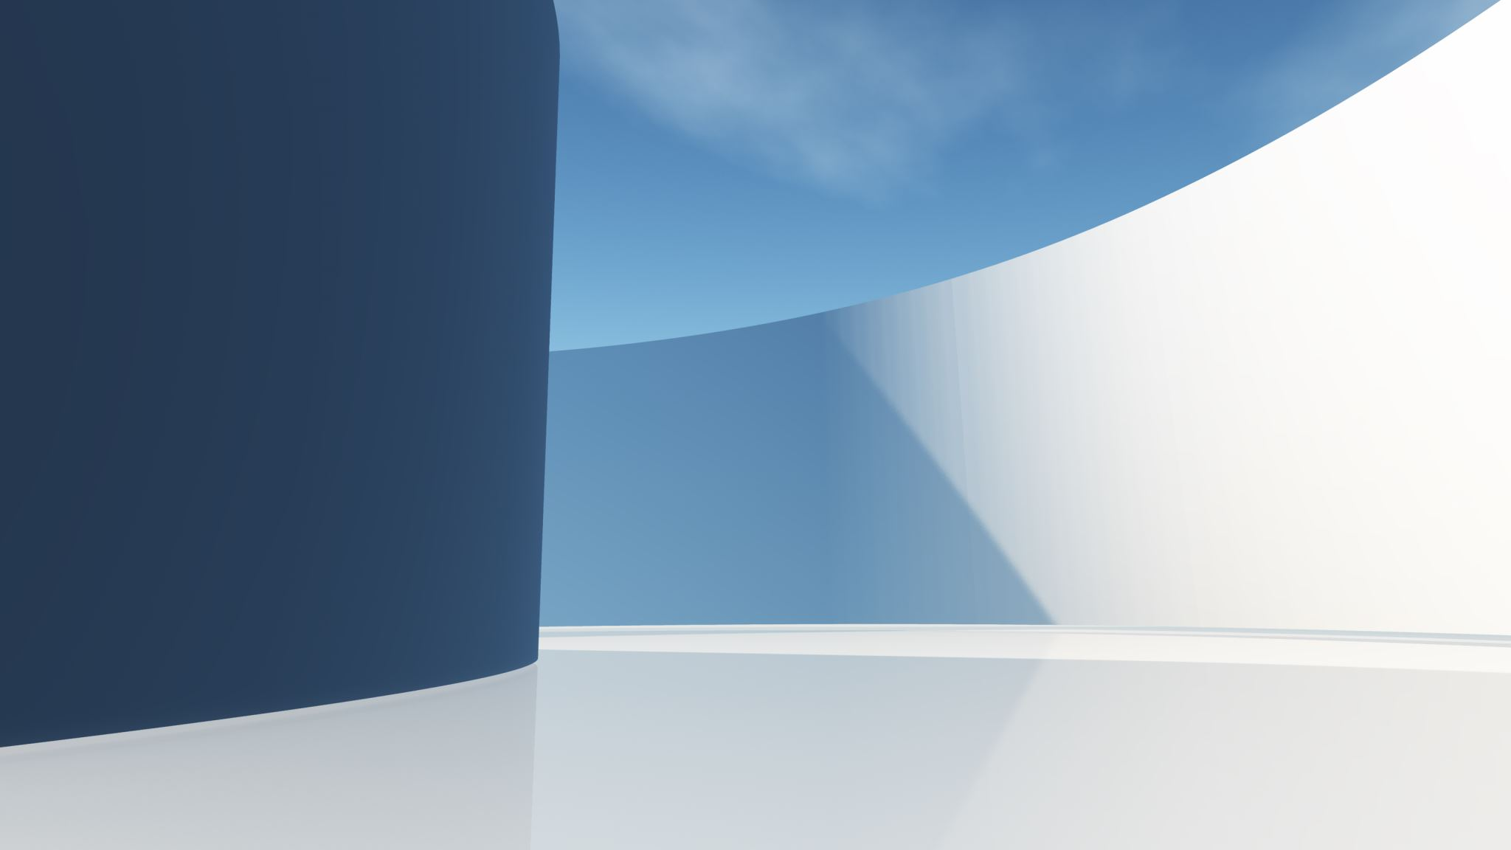
The Imapct of Social Media on Society

